Slide 1
Architectural Strategies for Large-Scale RAG Pattern Applications
Presenter
Title
Company
Email/Twitter/etc

Slide 2
Agenda
Azure Cosmos DB + GenAI
The Basics of vector embeddings
Vector indexing
Thinking about scale in Azure Cosmos DB
Demo

Slide 3

Azure Cosmos DB is the world’s most scalable AI database
Serverless or Provisioned Throughput
Automatic sharding/partitioning
High elasticity with instant autoscale
Low latency, real-time data transactions
Mission critical reliability (99.999%)
Bulit-in multitenancy
Native vector indexing and search with DiskANN

Slide 4






Use cases with Azure Cosmos DB
Chat history
Retrieval Augmented Generation (RAG)
Multi-tenant
AI apps
Real-time Recommendations
Real-time
Anomaly Detection
Multi-Agent AI

Slide 5
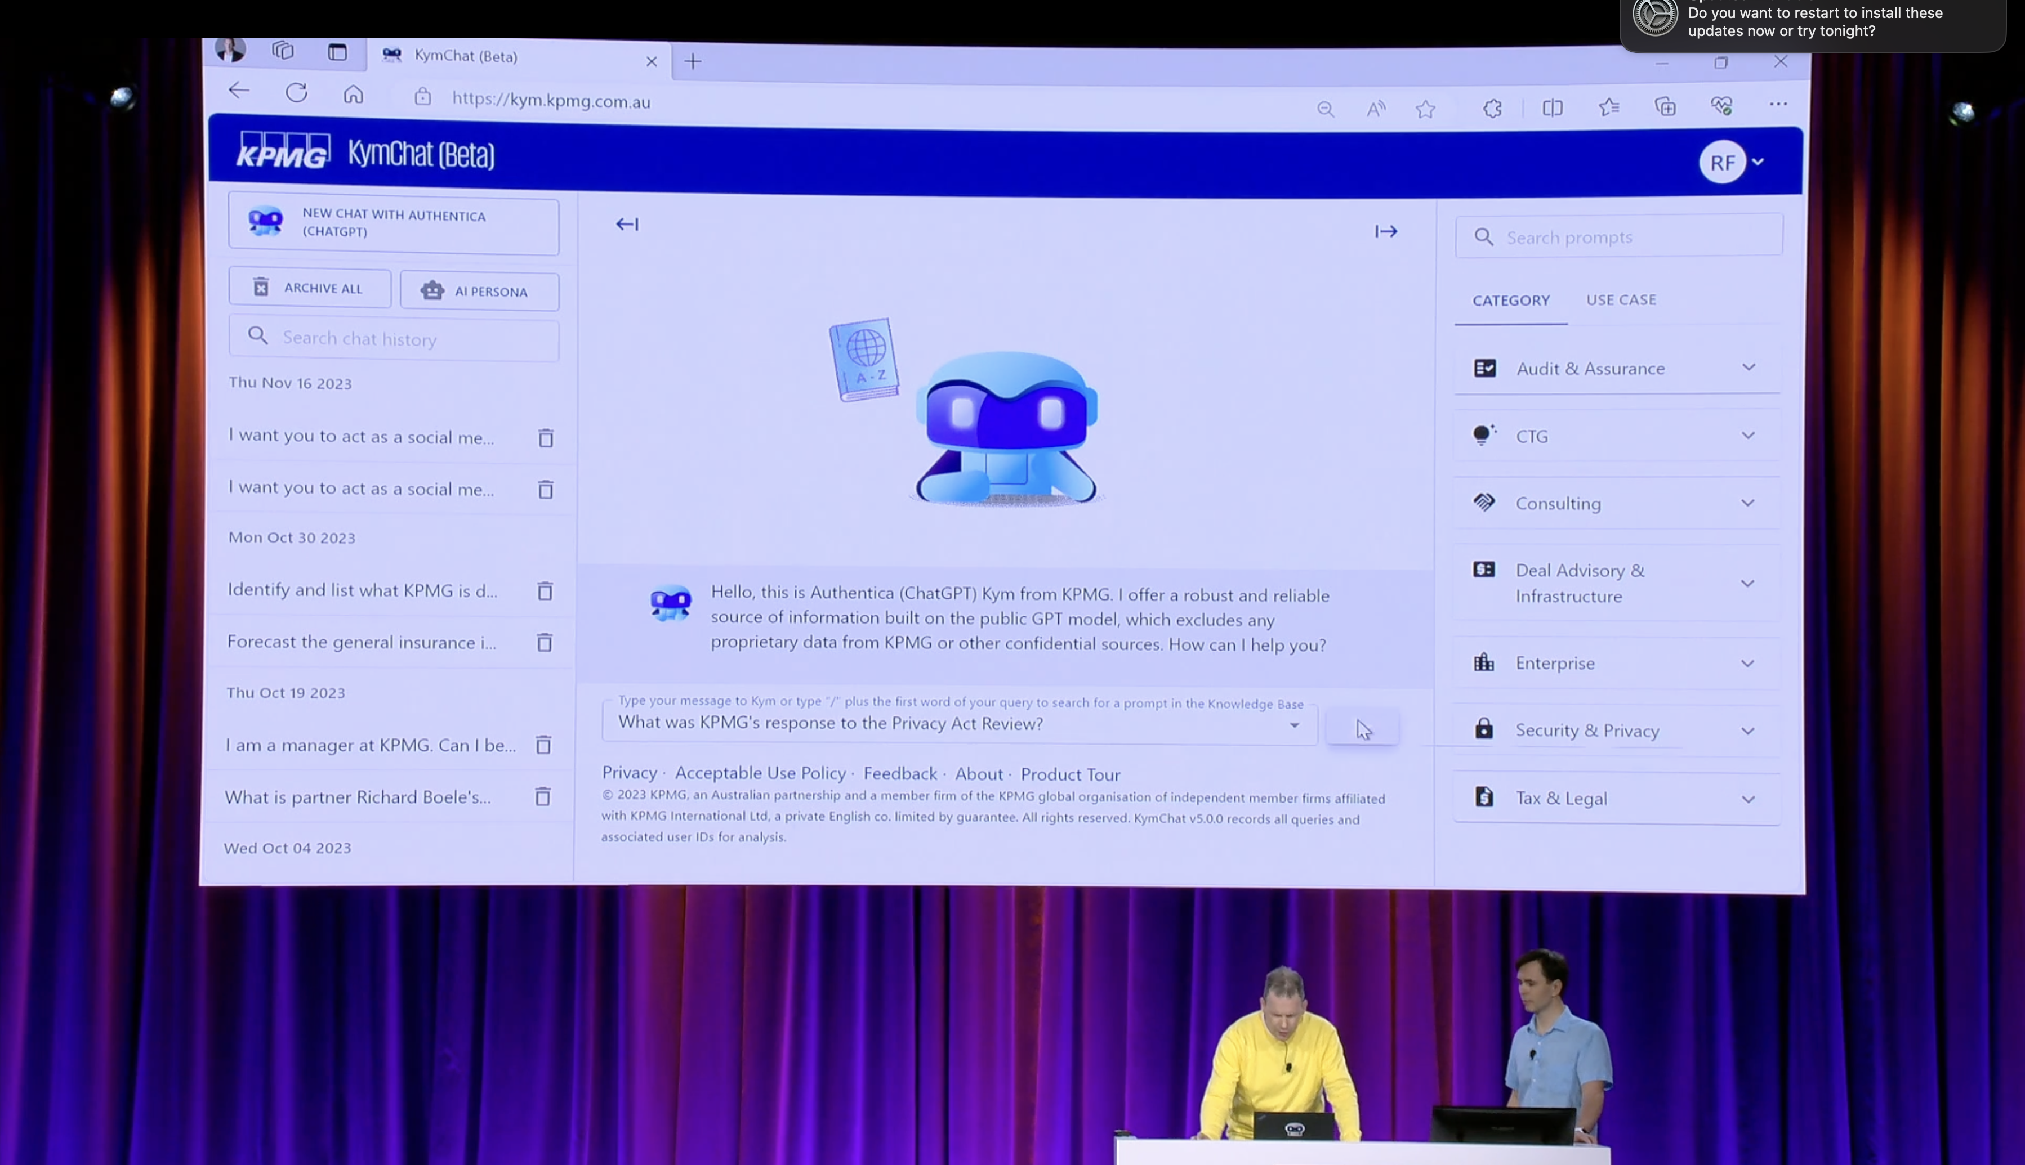




KymChat
KymChat is an AI agent to streamline KPMG employee operational tasks such as research, drafting proposals, documents, and communications.
Leveraging Vector Search in Azure Cosmos DB for MongoDB vCore enabled KPMG to provide value to their employees at scale.
KymChat demo at Ignite 2023
Accuracy
PCI, a key relevancy metric increased from 50% to 90%+
Performance
7,000+ employees
Up to 50% productivity gain
Scalability
Performance improvements enabled rollout to all KPMG member firms

Slide 6

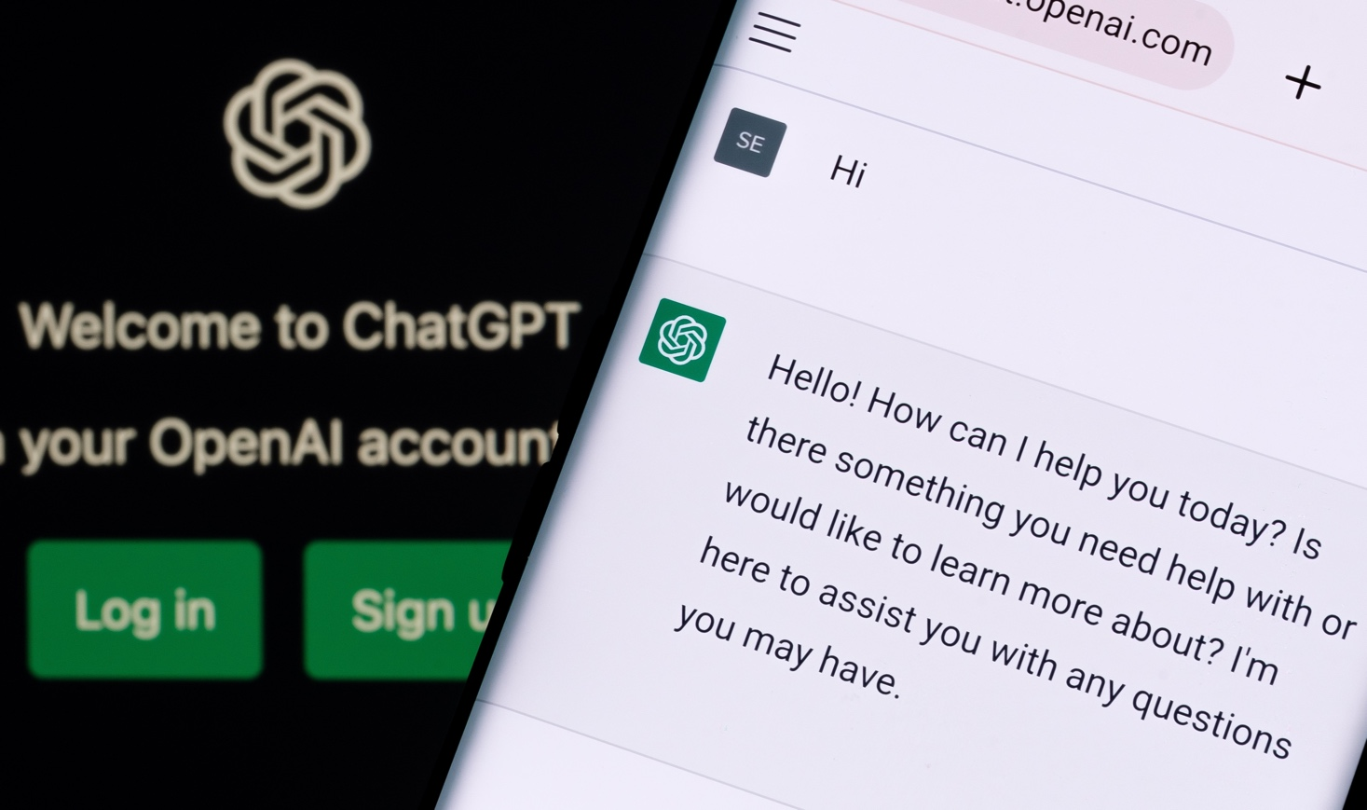



ChatGPT scales with Azure Cosmos DB
OpenAI
Challenge
Meet incredible demand from traffic spikes, without having to worry about database operations
Outcomes
Rapidly and seamlessly scaled as service grew, with zero downtime
Able to iterate fast on data shapes thanks to schemaless flexibility
Maintained high performance and availability
Key Azure products used:
Open AI stores ChatGPT conversations and all other user interactions in Azure Cosmos DB, 40+ workloads
Azure Cosmos DB
Azure Kubernetes Service
Azure AI Search

Slide 7
Back to basics

Slide 8
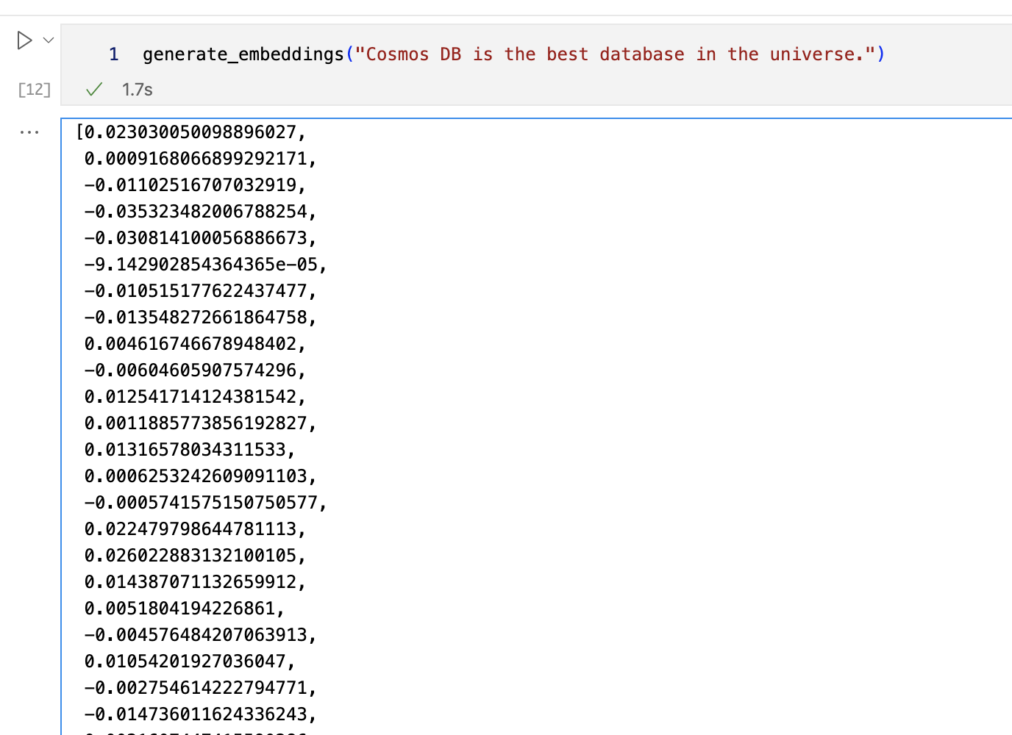
Vector embeddings are compact, semantically-rich representations of any data, typically an array of numbers (floats, ints, etc.)
It’s never been easier to generate embeddings from your data via APIs (OpenAI, Cohere) custom models (Hugging Face, Pytorch, etc.).
Closeness is measured by a distance metric (Cosine, Dot product, Euclidean (L2), Manhattan (L1), etc.)
Vectors that are close together in vector space are semantically similar.
Generally, two types of Vector Similarity Search:
Exact (kNN, brute-force, etc.) Compare query vector against all vectors in DB
Approximate (ANN): Intelligently search over fewer (and sometimes compressed) vectors leveraging algorithms and efficient data structures.
An example of OpenAI ada-002 embeddings

Slide 9
Vector Search Approaches
kNN
Brute force / Exact search
ANN
Compare query vector with every vector in your DB
100% recall/accuracy
Slow, scales linearly
Use indexes, clustering, graphs, etc. to lower # of compares
Popular types: HNSW, IVF, ScANN, DiskANN

Slide 10
Vector Index Storage
In Memory
On Disk
+ Fast
- Expensive
+ Cheap
- Slow

Slide 11
GenAI use cases with Azure Cosmos DB
What
Why
When
a
Drastically reduces latency
Saves on Token consumption
Reduces costs and latency for LLM
Semantic Caching
Slow moving / static content
FAQs, Policies…
Conversational context
UX improvements
LLM optimizations
Auditing
Chat History
A MUST for Chat sessions
Improving cost & performance
Retrieval Augmented Generation (RAG)
Personalize LLM on your data
Cheaper than fine tuning
Faster iteration on new data
Any workload for GenAI apps
Vector + Operational Database
No ETL
Consistent data
Reduce complexity & costs
Data & vectors together
Cosmos DB scale & performance

Slide 12
Azure Cosmos DB for NoSQL
Today
Native Vector Indexing and Search
Public Preview
DiskANN Index
Public Preview
Integrations
LangChain
Semantic Kernel
LlamaIndex
PromptFlow

Slide 13
Vector Search in Azure Cosmos DB for NoSQL
Store data + vectors together
Reduced Complexity & Cost
Transactional Data & Vectors
Optimized for App Developers
Vector Search
+ Query Filters
Combine with equality, range & spatial filters
Optimize query focus
Flexible
Indexing
Flat, quantized flat, and DiskANN indexing available
Azure Cosmos DB for NoSQL Capabilities
Serverless or provisioned throughput
Built-in multitenancy
Instant & dynamic autoscale
<10ms point-reads
Globally-replicated
Industry-leading 99.999% SLA

Slide 14
Vector Index Types in Azure Cosmos DB
Flat / kNN
Quantized Flat
DiskANN
Vectors stored on bw-tree index
100% Accuracy
Not recommended for Prod
Useful to find “ground truth”
Vectors are compressed, then stored on bw-tree index
97-100% Accuracy
Good for ~100k vectors and under
Compressed vectors in RAM, uncompressed graph on High-speed SSDs
High accuracy & tunable
Good for >80k vectors

Slide 15
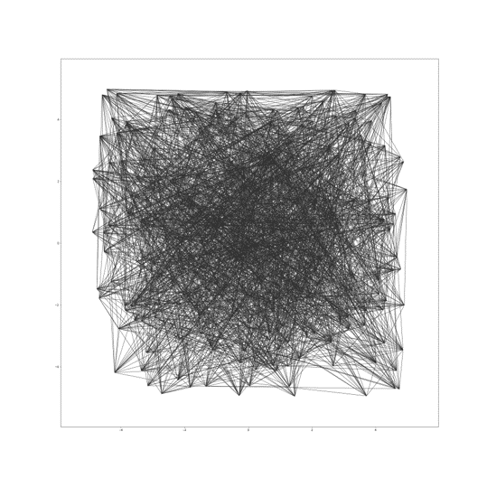

Vector Index Types in Azure Cosmos DB
Scalable and cost effective, ideal for multi-tenant apps
Vector compression
Storage and graph construction
Algorithms
Large Vectors
{ D1, D2, D3, D4, D5, …, D99, D100 }
RAM
Compressed vectors
Quantization
SSD
Compressed Vectors
{ D1, D2 .., D10 }
Full vectors + graph
Unlimited scale
Low latency
Robust to data changes
Serverless
^{*In preview, GA November ‘24}

Slide 16
DiskANN performance
Scenario | P50 Latency (ms) k=10/50 | P95 Latency (ms) k=10/50 | Avg Latency (ms) k=10/50 | Recall@k k=10/50
100k vectors | 25/95 | 29/108 | 25/95 | 92.47/98.03
1M vectors | 34/130 | 51/164 | 39/133 | 89.2/95.41
35M vectors | 108/544 | 166/879 | 112/569 | 90.73/95.67
Source: https://aka.ms/CosmosDiskANNBlogPart1
^{*In preview, GA November ‘24}

Slide 17
DiskANN RU Costs
Scenario | P50 RU Cost k=10/50 | P95 RU Cost k=10/50 | Avg RU Cost k=10/50 | Scenario
100k vectors | 36/159 | 39/169 | 36/159 | 100k vectors
1M vectors | 38/170 | 42/179 | 45/182 | 1M vectors
35M vectors | 282/1,249 | 300/1,298 | 282/1,245 | 35M vectors
Source: https://aka.ms/CosmosDiskANNBlogPart1
^{*In preview, GA November ‘24}

Slide 18
Monthly costs ($ USD)
Scenario | Manual (100% 10 QPS) | Manual (100% 100 QPS) | Autoscale (50% 1 QPS, 50% 10 QPS) | Autoscale (100% 10QPS) | Autoscale (50% 10 QPS, 50% 100 QPS) | Autoscale (100% 100 QPS)
100k vectors | $22.46 | $224.64 | $18.53 | $33.70 | $185.33 | $336.96
1M vectors | $24.19 | $241.92 | $19.96 | $36.29 | $199.58 | $362.88
35M vectors | $172.80 | $1,728.00 | $142.56 | $259.20 | $1,425.60 | $2,592.00
Source: https://aka.ms/CosmosDiskANNBlogPart1
^{*In preview, GA November ‘24}

Slide 19
Serverless vs Autoscale
Serverless
Cost-effective for intermittent workloads, development, and PoCs.
Pay only for consumed resources.
Simplifies development and deployment.
Autoscale
Automatically adjusts throughput, you define max.
Handles unpredictable traffic spikes.
Ensures consistent performance and availability.
Source: https://aka.ms/CosmosDiskANNBlogPart1
^{*In preview, GA November ‘24}

Slide 20
Sounds great… how do I get started?

Slide 21
How to get started
Create an Azure Cosmos DB for NoSQL account
Enable the Vector Search Preview
Create a new container with
A vector embedding policy
A vector index policy
Ingest your data items with vectors
Write a query using the VectorDistance function!

Slide 22
What’s a Container Vector Policy?
{
"vectorEmbeddings": [
{
"path": "/vector",
"dataType": "float32",
"dimensions": 256,
"distanceFunction": "cosine"
}
]
}

Slide 23
What’s a Vector Index Policy?
{
"vectorIndexes": [
{
"path": "/vector",
"type": ”diskANN"
}
]
}

Slide 24
What does a vector search query look like?
SELECT TOP 10 c.property1, c.property2
FROM c
ORDER BY VectorDistance(c.vector,<queryvector>)
SELECT TOP 5 c.name, c.description, VectorDistance(c.vector,<queryvector>) as SimilarityScore
FROM c
ORDER BY VectorDistance(c.vector,<queryvector>)

Slide 25

What might automated vectorization look like?
Azure Functions has built-in triggers for Azure Cosmos DB
Leverage Change-Feed to trigger data processing at every upsert
Do your chunking and vectorization (calls to Azure OpenAI) on every triggered action

Slide 26
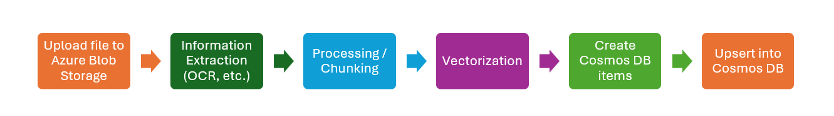
What about ingesting document data?
Source: https://aka.ms/Doc2CDB

Slide 27
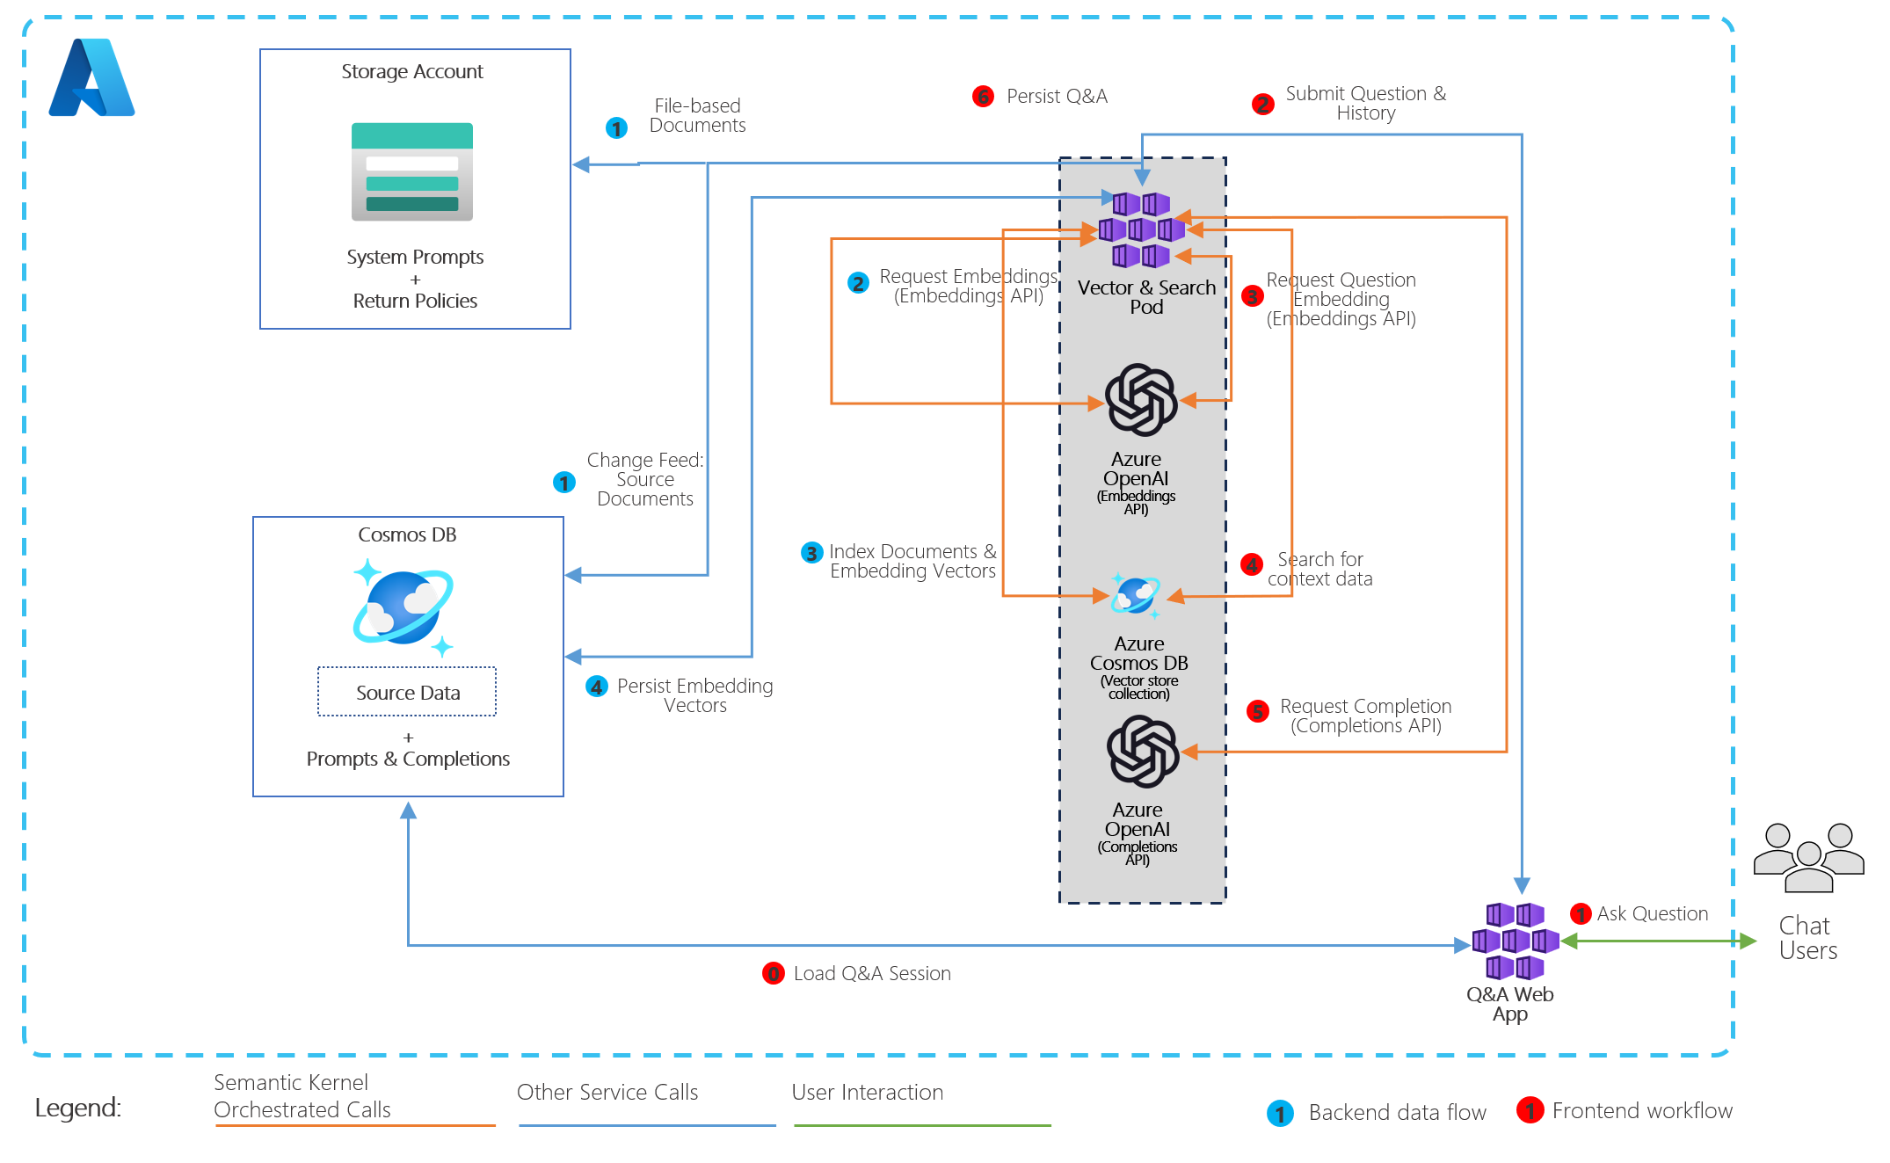
What might an app architecture look like?

Slide 28
Azure Cosmos DB + AI
Considerations for scale

Slide 29


Azure Cosmos DB structure
Database Account
…
Database
Database 2
Database N
…
Container
Container
Container
…
Logical Partition
Logical Partition
Logical Partition
…
Physical Partition
Physical Partition

Slide 30
Partition Keys
Determine how your data is distributed
Physical partition → physical machine owns range of pk values
Logical partition → partition key value
DeviceId
DayOfWeek

Slide 31
Partitions Keys
Determine how your requests are distributed
SELECT * FROM c WHERE c.DeviceId = ‘123’
SELECT * FROM c WHERE c.DeviceId = ‘123’
123
123
123
123
123
123
DeviceId
DayOfWeek

Slide 32
Characteristics of a good partition key
Value doesn’t change
Wide range of possible values
Similar amount of data for all values
Spreads requests evenly across values
Appears in most queries
Spreads writes across values

Slide 33
Let’s try it out!
Build a Movie Chatbot (RAG, Chat History, Semantic Caching)
Python
Azure Cosmos DB for NoSQL
Azure Open AI Services

Slide 34
What’s next?
New integrations
& assets
Performance improvements
Tunable configurations
DiskANN
Generally Available
Document ingestion
Private preview
Full-text Search
Public Preview
Text Ranking (BM25) Public Preview
Hybrid Search
Public Preview
Full-Text & Hybrid Search
Generally Available
Stay tuned…
More to come in 2025

Slide 35
Azure AI Advantage free offer
Up to $6,000 Azure Cosmos DB free for 90 days¹
Eligibility: customers using Azure AI Services or GitHub Copilot
Why Azure Cosmos DB for Era of AI
AI ready
Guaranteed performance and scale
Flexibility and efficiency
Mission critical
Learn more: Aka.ms/AzureAIAdvantageBlog
*Terms & conditions: Offer available to all Azure customers who are using or will use Azure AI Services (including Azure OpenAI Service), Azure Machine Learning, Azure AI Search) and/or GitHub Copilot. Offer provides 40,000 RU/s for free for a 90 day period. Offer only available where Azure Cosmos DB available. Customers must create a new Azure Cosmos DB account and register via Microsoft Form at https://aka.ms/AzureAIAdvantageSignupForm. Time period: the last day for customers to opt-in for the offer via the signup form is June 30, 2024.

Slide 36
Learn more about building AI apps with Azure Cosmos DB!
Vector search overview
Docs, demos, videos and more
PDF/Office doc ingestion into Cosmos
Blog post on DiskANN performance
Try Azure Cosmos DB Free Trial
aka.ms/CosmosVectorSearch aka.ms/AzureCosmosDB/Gallery/AI
aka.ms/Doc2CDB
aka.ms/CosmosDiskANNBlogPart1
aka.ms/TryCosmos

